Slide 1

Vel Tech Rangarajan Dr. Sagunthala R&D Institute of Science and Technology
School of Computing
Department of Computer Science and Engineering
10211CS224 / FULL STACK APPLICATION DEVELOPMENT (JAVA)
PROJECT REVIEW : MILESTONE PROJECT – 1
Date: DD-MM-YYYY
Dynamic Online Examination & Result Processing System
SDG: SDG 4 – Quality Education
Presented By:
P.LIKITHA HARSHINI DEVI– VTU26654
Reg.No:-23UECS0456
Courses Handling Faculty:
Dr. S . HEMAMALINI – M.E., Ph.D.,

Slide 2
INTRODUCTION
Background of the problem:
The traditional exam system is slow and manual, so a dynamic online system is needed to manage exams and results efficiently.
Why this project is important:
This project is important because it makes conducting exams faster, easier, and more accurate by automating question management and instant result processing.
Real-world relevance:
This system is widely used in schools, colleges, and companies to conduct online exams and quickly evaluate results efficiently.
Brief overview of the system:
The system is a web-based platform where admins can add questions and monitor results, while students can select subjects, take exams, and receive instant scores.
1
2
3
4
5
6
7
8
9

Slide 3

PROBLEM STATEMENT
1
2
The traditional examination process is often manual, time-consuming, and prone to errors in question handling, exam conduction, and result evaluation. Managing large numbers of students becomes difficult, and delays in result processing reduce efficiency and transparency. Therefore, there is a need for a dynamic online examination and result processing system that allows admins to manage questions and monitor performance, while enabling students to take exams and receive instant, accurate results.
3
4
5
6
7
8
9

Slide 4
OBJECTIVE(S)
1
2
1)To develop an online platform for conducting exams in an efficient and user-friendly manner.
This helps reduce manual effort and saves time for both admins and students.
2)To enable admins to easily add, update, and manage questions while monitoring student performance.
This ensures better control, accuracy, and organization of the examination process.
3)To provide students with instant and accurate results after completing exams.
This improves transparency and allows quick evaluation of performance.
3
4
5
6
7
8
9

Slide 5
PROPOSED SYSTEM
1. Automates the entire examination process and reduces manual work.
This saves time and improves overall efficiency.
2. Provides secure admin login for managing questions and monitoring results.
This ensures better control and organization of exams.
3. Allows students to select subjects and take exams easily online.
This offers flexibility and convenience to users.
4. Evaluates answers automatically and generates instant results.
This reduces errors and speeds up result processing.
5. Maintains a centralized database for storing exam and student data.
This helps in easy access and data management.
6. Supports multiple users taking exams at the same time.
This ensures smooth performance even with high usage.
7. Tracks student performance and generates reports.
This helps in analyzing progress and improvement.
8. Improves accuracy, transparency, and reliability of the system.
This enhances trust in the examination process.
1
2
3
4
5
6
7
8
9

Slide 6
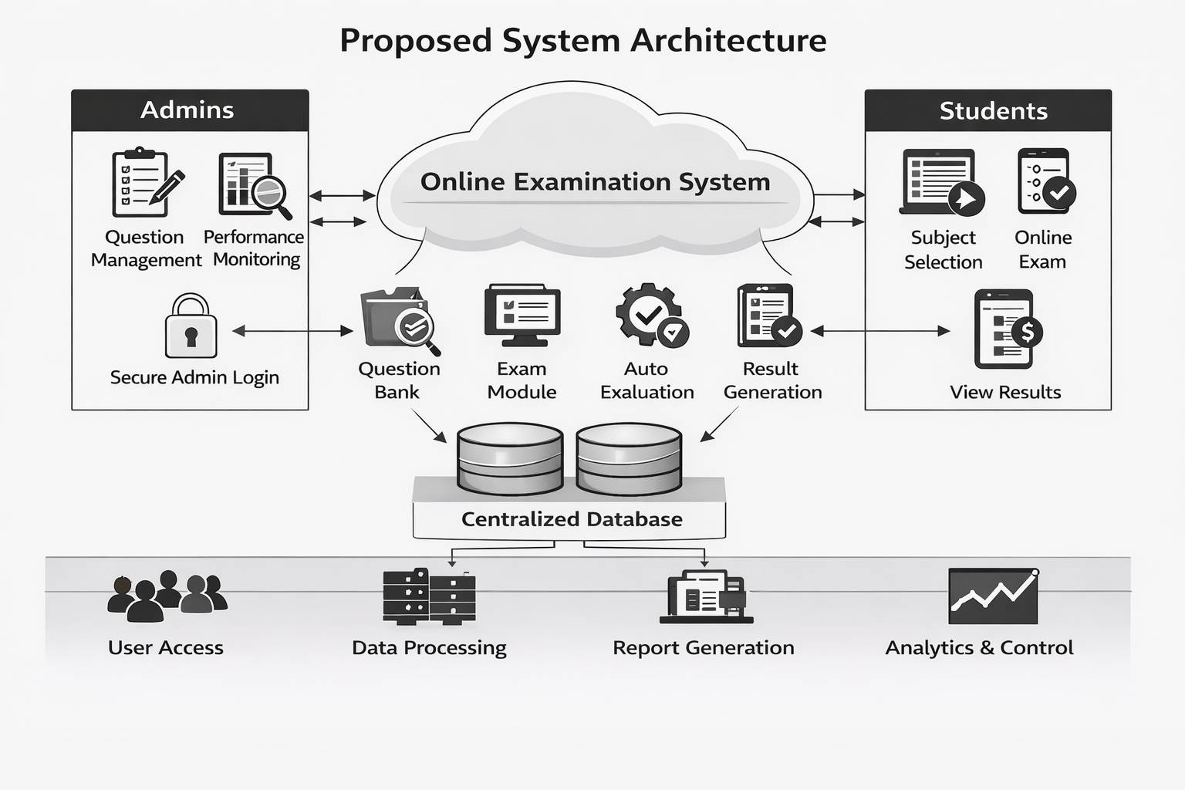
PROPOSED SYSTEM ARCHITECTURE
1
2
3
4
5
6
7
8
9

Slide 7
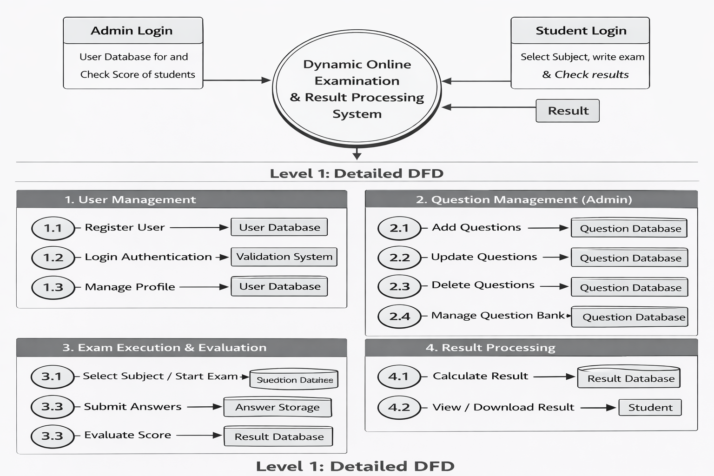
WORKFLOW
1
2
3
4
5
6
7
8
9

Slide 8
TECHNOLOGIES USED
Frontend:
1.HTML5
2.CSS3
3.Javascript
Thymeleaf
Backend:
1.Java Spring Boot
2.Java17
Data Base / Tools:
1.MySql
Software Requirements:
1.Windows / Mac
2. Web Browser
1
2
3
4
5
6
7
8
9

Slide 9
MODULE DESCRIPTION
Module 1: User Management
Handles student and admin registration and login with secure authentication.
Manages user profiles and access control for both admin and students.
Module 2: Question Management (Admin)
Allows admin to add, update, and delete questions in the system.
Maintains the question bank and monitors student performance.
Module 3: Exam Processing
Enables students to select subjects and take exams online.
Processes answers and performs automatic evaluation of scores.
Module 4: Result Management
Generates and stores student results after evaluation.
Allows students to view results and admins to analyze performance.
1
2
3
4
5
6
7
8
9

Slide 10
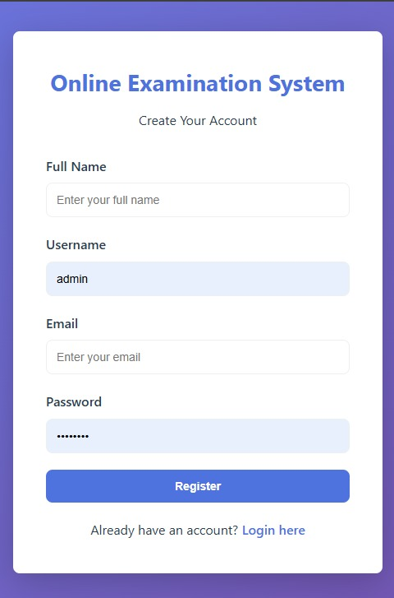
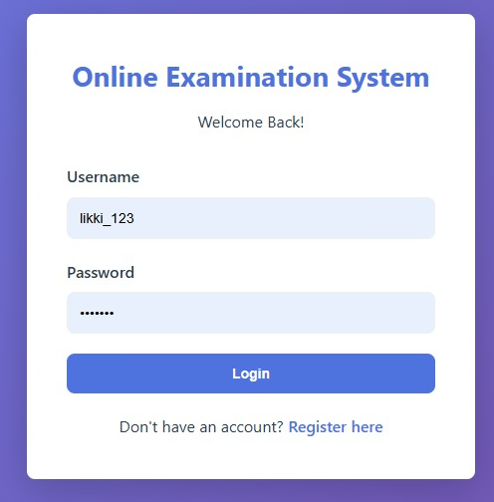
IMPLEMENTATION SCREENSHOTS
1
2
3
4
5
6
7
LOGIN PAGE
8
9
REGISTRATION PAGE

Slide 11
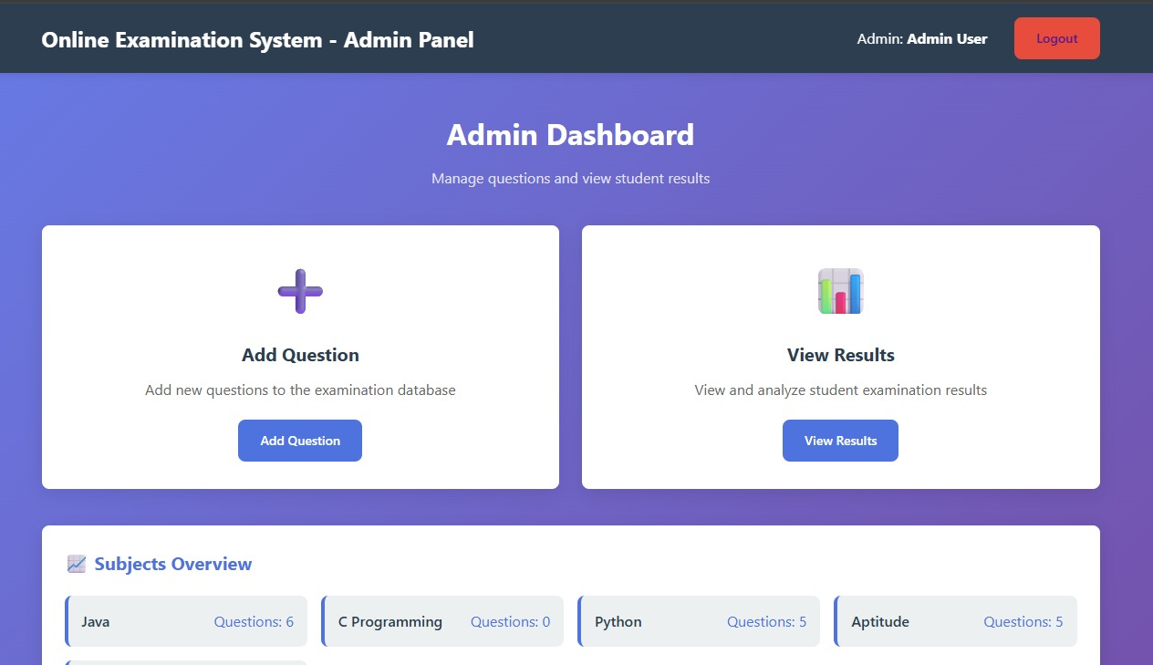
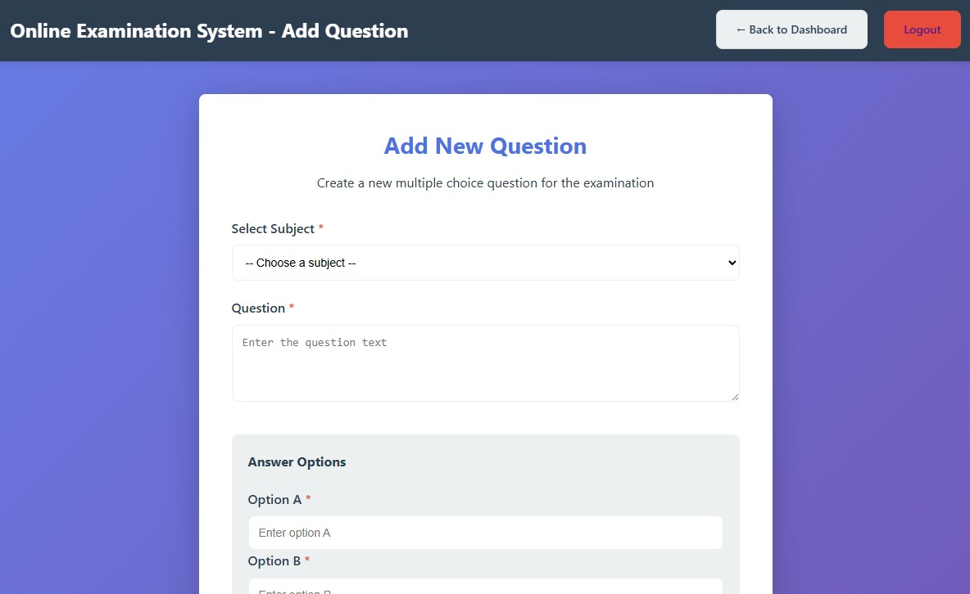
IMPLEMENTATION SCREENSHOTS
1
2
3
4
5
6
7
ADMIN PAGE
8(A)
9
ADD QUESTION MODULE

Slide 12
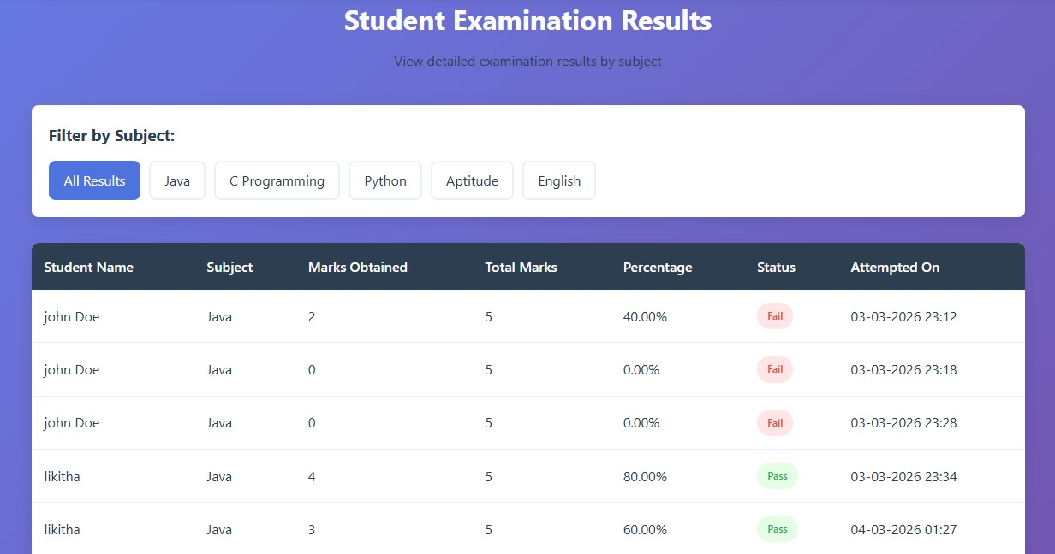
IMPLEMENTATION SCREENSHOTS
1
2
3
4
5
6
7
8(B)
9
VIEW RESULTS MODULE

Slide 13
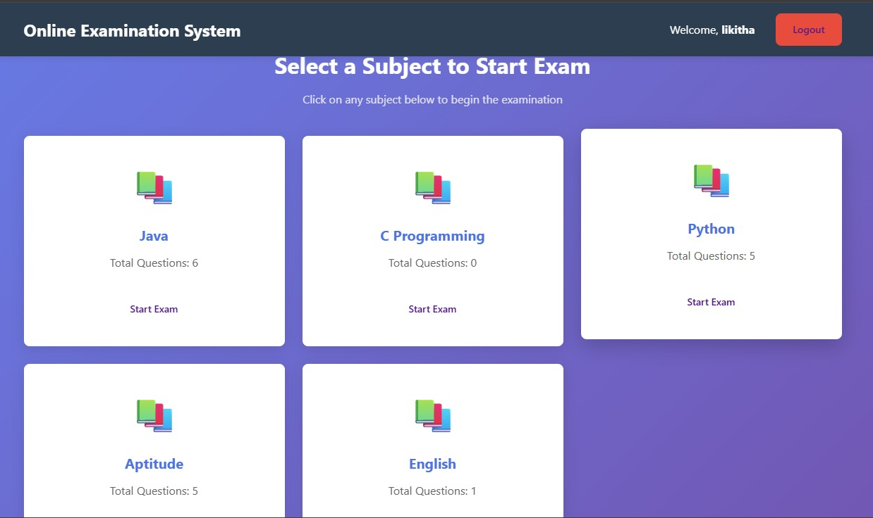
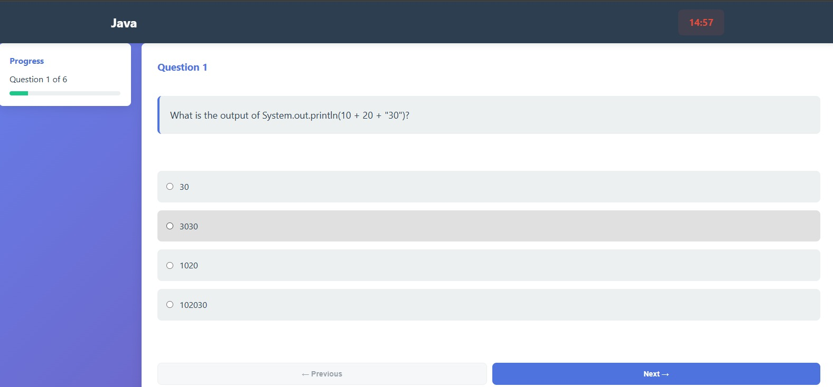
IMPLEMENTATION SCREENSHOTS
1
2
3
4
5
6
7
STUDENT MODULE
8(C)
9
EXAM MODULE

Slide 14
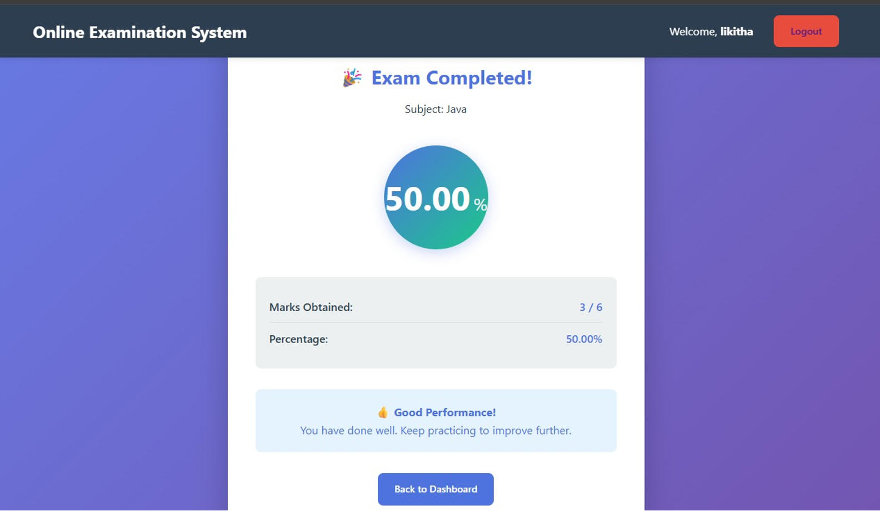
IMPLEMENTATION SCREENSHOTS
1
2
3
4
5
6
7
8(C)
9
VIEW RESULTS MODULE

Slide 15
ADVANTAGES & LIMITATIONS
1
Advantages:
1)Saves time by automating exam and result processing.
2)Reduces manual errors in evaluation.
3)Provides instant results to students.
4)Easy question management for admin.
5)Accessible from anywhere (online system).
6)Handles multiple students simultaneously.
Limitations:
1)Requires stable internet connection.
2)Possibility of technical issues during exams.
3)Security risks like cheating or hacking.
3)Depends on system performance and server load.
4)Initial setup and maintenance cost is required.
2
3
4
5
6
7
8
9

Slide 16
Thank you

